Slide 1
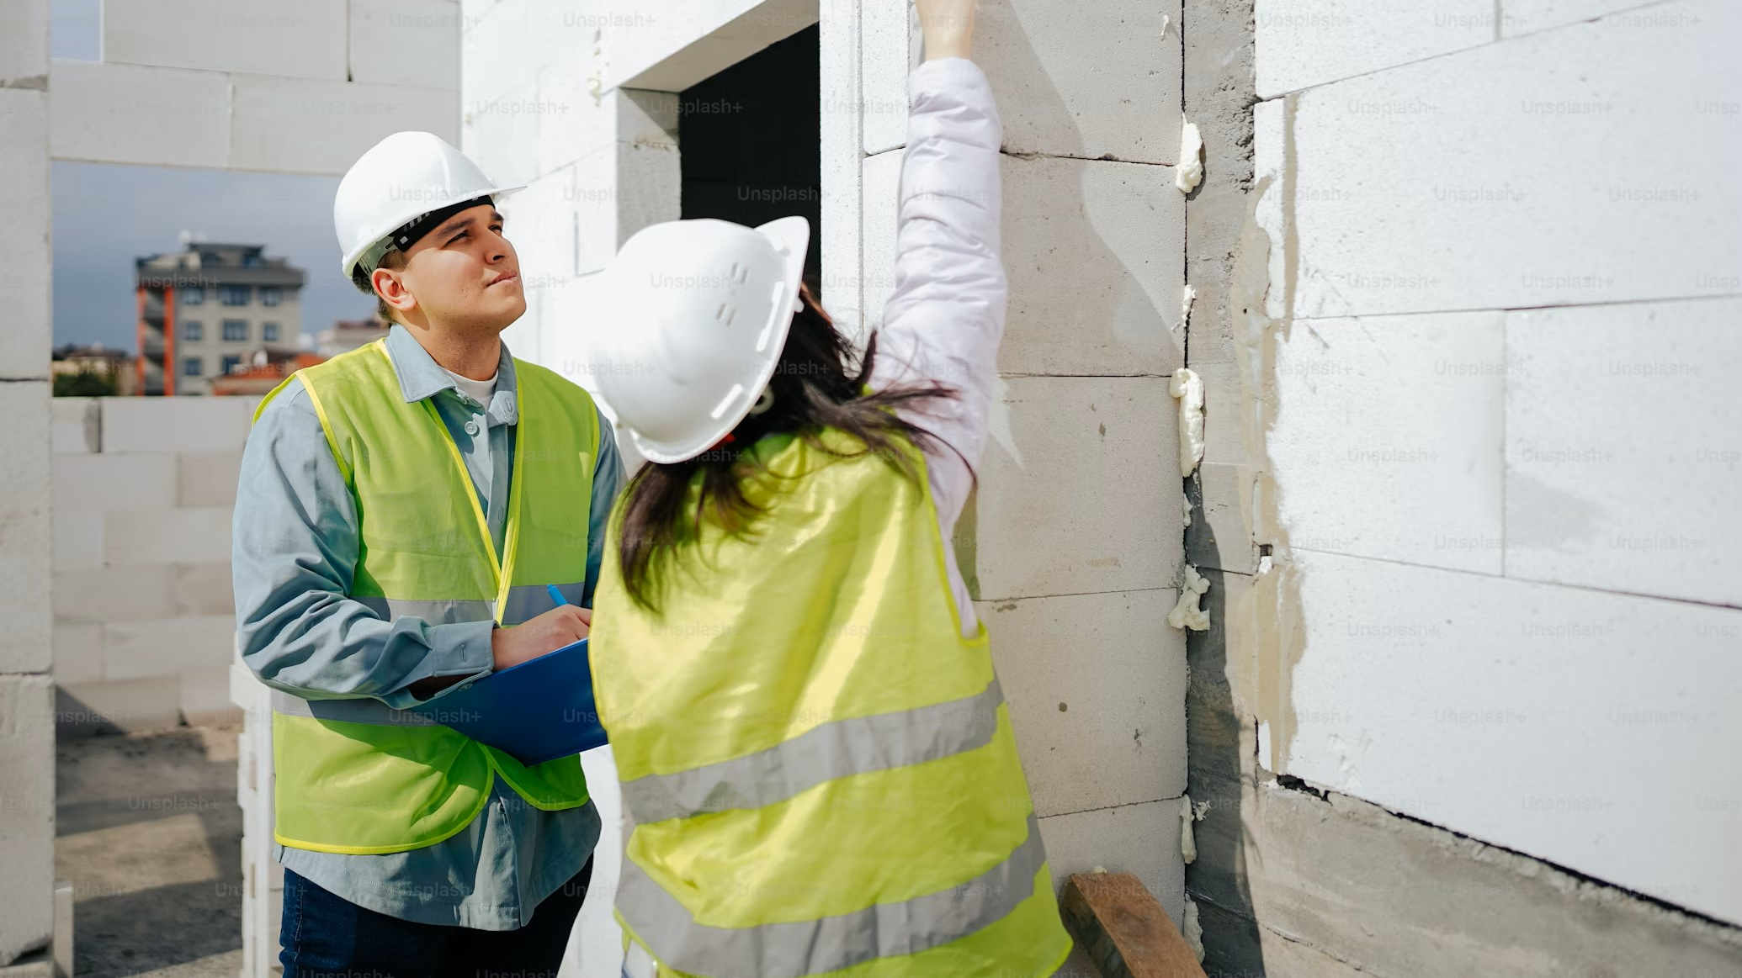
Enhancing Construction Inspection through Retrieval-Augmented Large Language Models (RAG-LLM): Integrating Real-Time Data Retrieval with Automated Report Generation.
DSCI 6004-01 NATURAL LANGUAGE PROCESSING
FINAL PROJECT PROPOSAL, SPRING 2025
Supraja Madala
Reihaneh Samsami
Supervised by Dr. Khaled Sayed

Slide 2

PROJECT TOPIC
The complexity of construction inspection demands that inspectors not only assess physical sites but also ensure compliance with frequently updated safety standards, building codes, and project-specific requirements.
Current practices heavily rely on manual review, which is time-consuming and prone to errors, especially when regulations or project details change rapidly.
The challenge lies in providing inspectors with immediate access to the latest, relevant information while automating the documentation process to improve efficiency.
This project addresses these challenges by proposing a Retrieval-Augmented Generation (RAG) system integrated with a Large Language Model (LLM) to automate report generation and enable real-time data access.

Slide 3

PROJECT OBJECTIVES
The primary objective of this project is to develop an integrated RAG-LLM system that enhances construction inspection by automating report generation and enabling real-time access to up-to-date regulations, building codes, and project documentation.
Additionally, the system seeks to support inspectors in making more informed decisions by retrieving contextually relevant information during the inspection process.

Slide 4

PROJECT CONTRIBUTION
By automating report generation and enabling real-time data retrieval, the proposed system reduces the reliance on manual, time-consuming tasks and enhances the accuracy of compliance checks.
This ensures that inspections are aligned with the latest regulatory standards, minimizing the risk of oversights or delays due to outdated information.
Additionally, the project contributes to the industry by showcasing a scalable model for integrating AI into inspection workflows, potentially transforming traditional practices into more efficient, data-driven operations that promote safety, cost-effectiveness, and regulatory adherence in construction projects.

Slide 5

BRIEF LITEARURE REVIEW
Advancements in AI have highlighted the potential of LLMs and LangChain for improving data processing and automation in construction. Studies demonstrate that these tools can significantly enhance productivity and accuracy in various construction applications. However, limitations such as data scarcity and the need for comprehensive real-time data access indicate areas for further research (Jeong et al., 2024)​
The introduction of LLaMA, a highly efficient LLM, has enhanced NLP capabilities in construction, particularly in handling unstructured data from inspection logs and site reports. Combined with RAG, LLaMA retrieves up-to-date information from external databases, enabling real-time report generation that aligns with the latest regulations (Xue, 2021; Eastman, 2009)​

Slide 6
BRIEF LITEARURE REVIEW
A RAG-LLM integration model in construction inspection automates report creation while ensuring compliance by retrieving current standards from relevant databases. This integration not only improves report accuracy but also reduces human error, supporting safer and more efficient construction practices (Awada, 2020; Feng, 2021).
Moreover, combining AI frameworks like Mixture of Experts (MoE) with RAG facilitates dynamic information retrieval and reasoning, providing adaptable and contextually aware insights for construction inspection tasks. These advancements suggest that AI-driven inspection models could transform traditional practices, promoting greater accuracy, efficiency, and regulatory compliance (Xiong and Zheng, 2024)

Slide 7
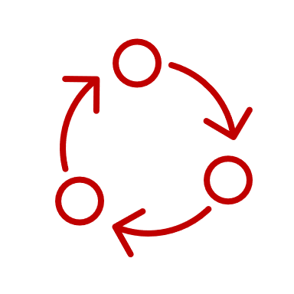
RESEARCH METHOD
1. Data Collection and Preparation
Collect construction inspection data from documents like inspection reports, guidelines, and standards in PDF format.
Use RecursiveCharacterTextSplitter to split large documents into manageable text chunks.
2. Model Architecture and Algorithms
Embedding Generation: Use Vector Embeddings to convert text data into vector representations.
Vector Search: Implement PGVector for efficient retrieval of documents based on user queries.
NLP: Use MistralLLM to interpret and generate responses to inspection-related queries.
3. System Workflow and Tools
Framework: Build the pipeline using LangChain.
Database: Store vector embeddings in PostgreSQL to enable efficient querying.
Web Development: Use Python and Flask for building the web application interface.
4. Evaluation
Assess the system’s effectiveness by comparing generated reports with human-written ones.
Evaluate accuracy, relevance, and compliance with current standards.

Slide 8

DELIVERABLES
1. Codebase
Document Embedding Pipeline: Scripts for extracting text from construction documents and converting them to vector embeddings using OllamaEmbeddings.
API Endpoints: Flask API to handle user queries and return relevant document data.
2. Documentation
API Documentation: A user guide detailing API access, endpoint specifications, and example queries.
User Manual: Instructions for system setup, including environment configuration, database setup, and document loading procedures.
3. Testing and Validation Files
Test Scripts: Automated tests to verify embedding accuracy and API responsiveness.
Sample Queries: A set of common inspection-related queries to validate retrieval capabilities and system performance.

Slide 9

EVALUATION METRICS
Evaluation Metrics
Embedding Accuracy: Measure the precision of document retrieval based on user queries using Bluescore similarity scores to ensure relevance.
Response Quality: Evaluate the relevance and clarity of responses generated by LLM for a variety of inspection-related queries.
System Performance: Analyze API response times and throughput, particularly during peak usage, to assess efficiency and scalability.
Validation Techniques
Relevance Testing: Test accuracy and relevance with predefined inspection queries.
API Performance Testing: Load test for robustness under concurrent requests.
User Feedback Collection: Gather user insights on response accuracy and clarity.

Slide 10

REFERENCES
1. Jeong, J., Gil, D., Kim, D., & Jeong, J. (2024). Current Research and Future Directions for Off-Site Construction through LangChain with a Large Language Model. Buildings, 14(8), 2374.
2. Zhong, B., Xing, X., Luo, H., Zhou, Q., Li, H., Rose, T., & Fang, W. (2020). Deep learning-based extraction of construction procedural constraints from construction regulations. Advanced Engineering Informatics, 43, 101003.
3. Xue, X., & Zhang, J. (2021). Part-of-speech tagging of building codes empowered by deep learning and transformational rules. Advanced Engineering Informatics, 47, 101235.
4. Xiong, X., & Zheng, M. (2024). Merging Mixture of Experts and Retrieval Augmented Generation for Enhanced Information Retrieval and Reasoning.
5. Wilkins, J., & Rodriguez, M. (2024). Higher Performance of Mistral Large on MMLU Benchmark through Two-Stage Knowledge Distillation.
6. Chen, H., Lin, X., & Gong, B. (2024) ANSAE: An Ai-Native Saas Manufacturing and Management Platform Based on LLM and Multi-Agent Clustering System. Retrieved from https://doi.org/10.2139/ssrn.4795529.
7. PGVector. (n.d.). PGVector: A vector search extension for PostgreSQL, enabling efficient similarity searches with vector embeddings, Retrieved November 30, 2024, from https://github.com/pgvector/pgvector.
8. Docker, Inc. (n.d.). Docker documentation: A platform for developing, shipping, and running applications in containers, Retrieved November 30, 2024, from https://docs.docker.com.
9. Ollama, Inc. (n.d.). Ollama documentation: A service providing various AI-driven tools, Retrieved November 30, 2024, from https://oollama.com.

